Slide 1
Intune controls my devices with telepathy right?
Deep dive into the IME, what is it, what is it responsible for and can we control this mystical beast

Slide 2


Speaker – Who is this guy?
Focus
Certifications
Extreme patching
Certified secret agent
MVP
From
Hobbies
Mother (UK)
Teaching local youth about hardstyle dancing
Blogs at
MSEndpointMgr.com
PatchTuesday.com
Byteben.com
Contact
Lenses
@byteben
Ben Whitmore

Slide 3
Agenda
What is the IME?
How is the IME installed?
How does the IME process app policy?
How does the IME process scripts?
Digging into win32app policy event state messages
Try again, how the IME handles failures and retries
Inventory
Invoke IME actions remotely like a boss
Q&A

Slide 4
What is the IME?

Slide 5

What is the IME?
Intune Management Extension (IME) is:-
A component of Microsoft Intune
Used to deploy and execute PowerShell scripts or Win32 applications on Windows devices that are enrolled in Intune
Responsible for the ugliest log file in the world
IntuneManagementExtension.log

Slide 6


What is the IME?
ConfigMgr Apps, Policy, Scripts
Intune Apps and Scripts, Custom Compliance Policies
Intune Config, Apps (LOB)
ConfigMgr Client (MSI)
IME (MSI)
Windows MDM Agent Built in to the OS
Agents Everywhere

Slide 7
How is the IME Installed?

Slide 8
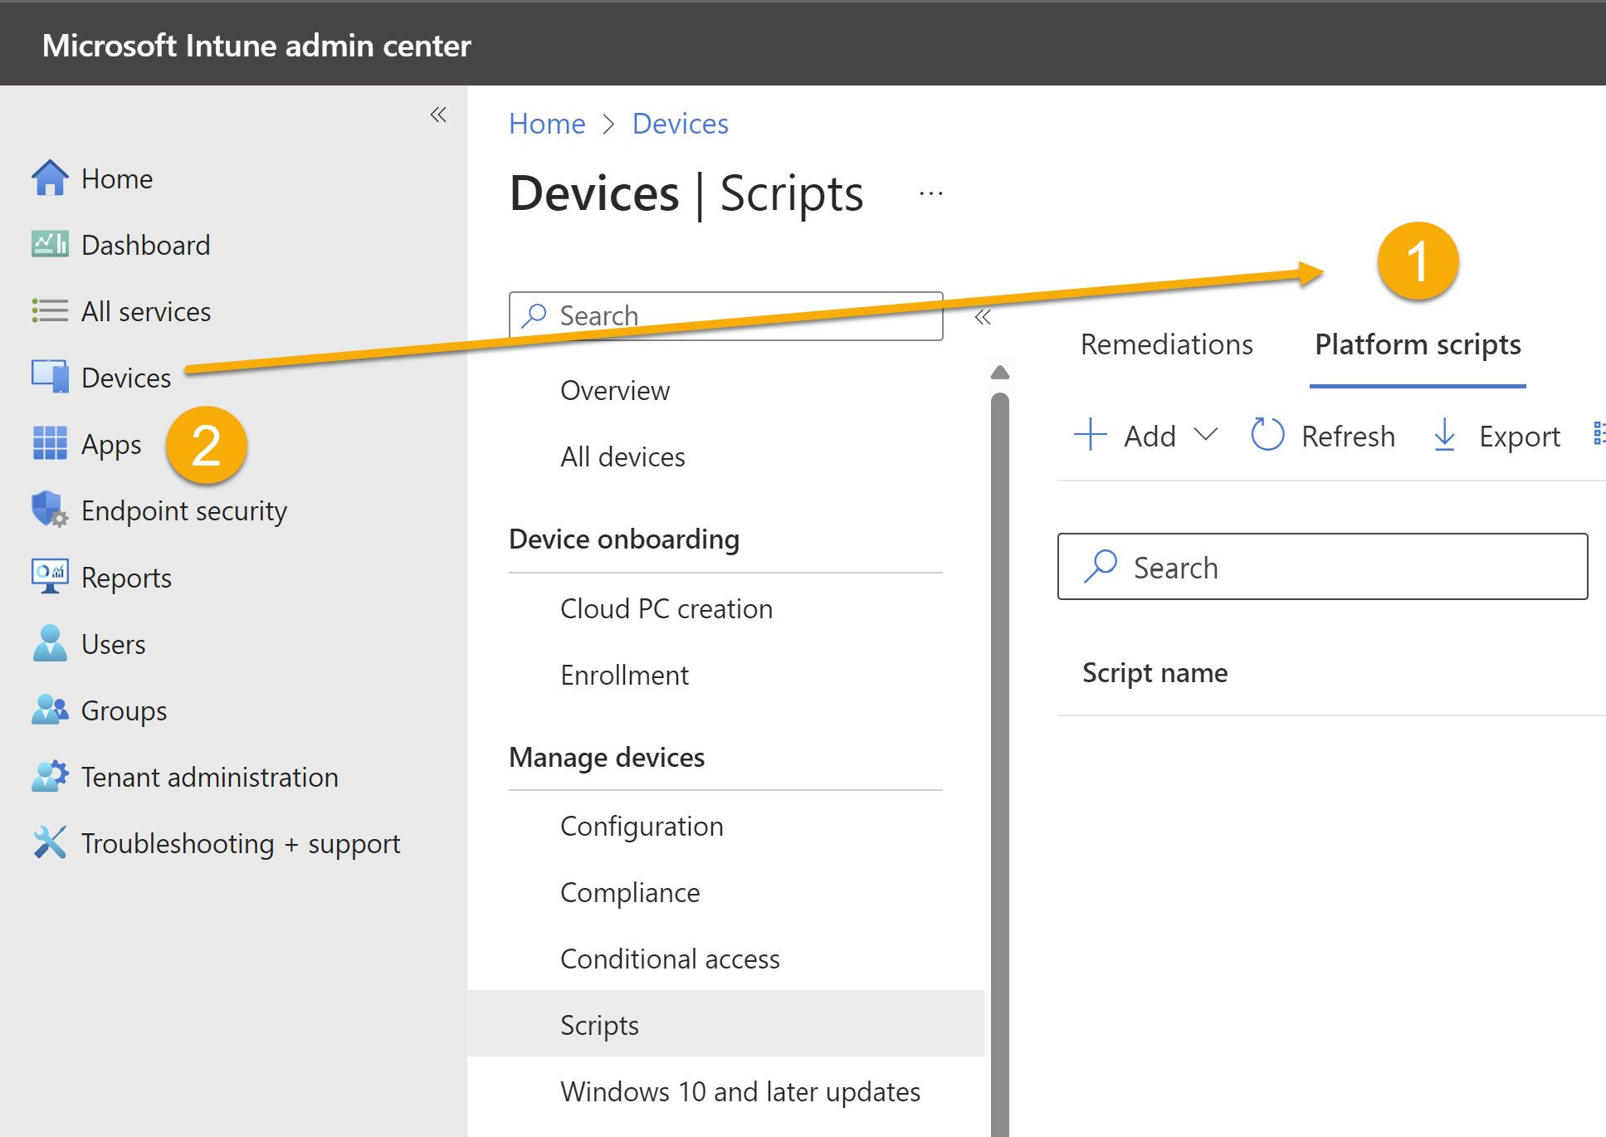
How is the IME installed?
The IME is installed when a managed device is targeted with either a:-
PowerShell Script or Proactive Remediation
Win32 app or Microsoft Store app
🥳 New🥳 Custom compliance settings

Slide 9
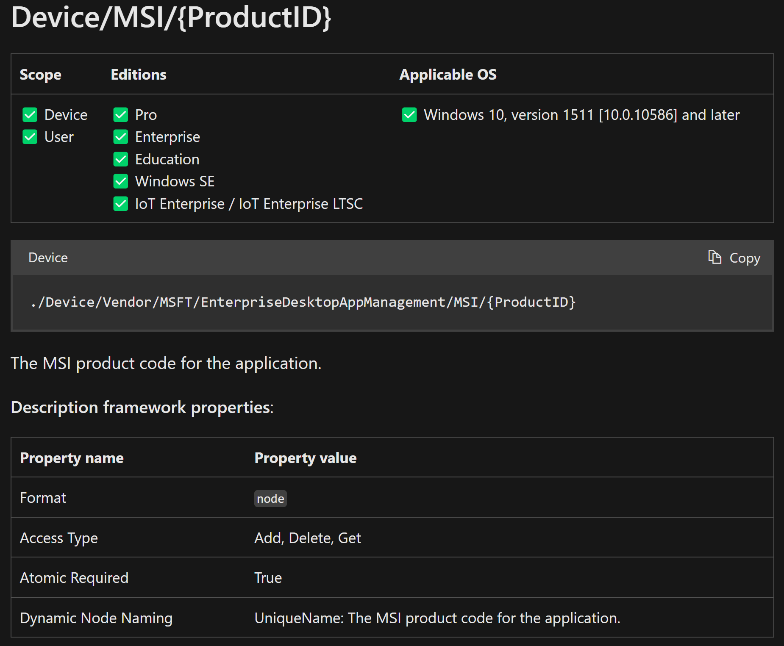
How is the IME installed?
The IME is installed, from an MSI, via the OMA-DM channel using the:-
EnterpriseDesktopAppManagement Configuration Service Provider (CSP)
This CSP is used to handle enterprise desktop application management tasks, such as querying installed enterprise applications, installing applications, or removing applications.
https://learn.microsoft.com/en-us/windows/client-management/mdm/enterprisedesktopappmanagement-csp

Slide 10
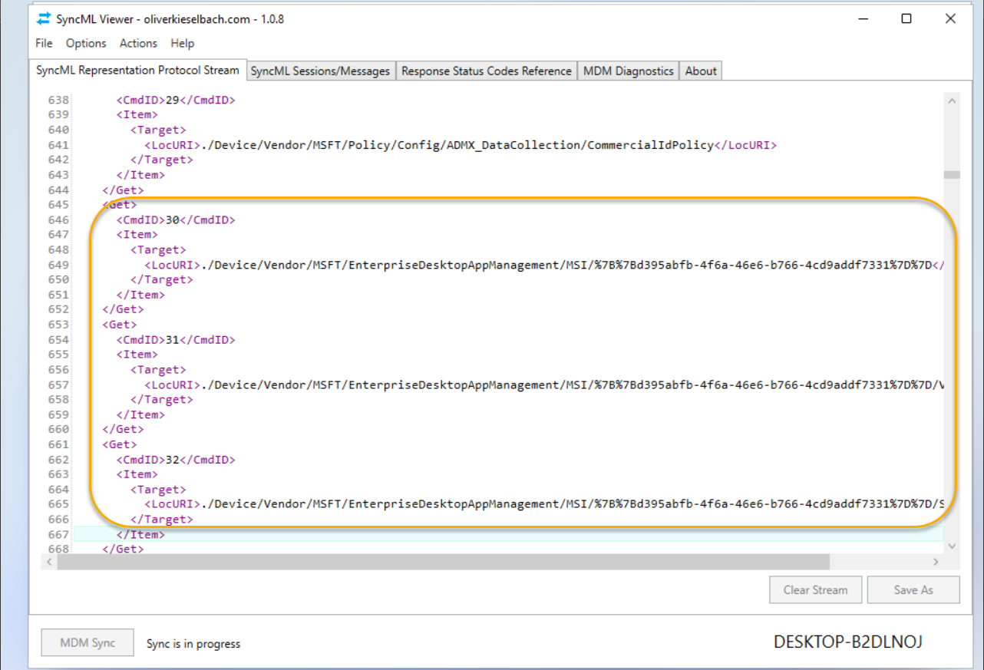

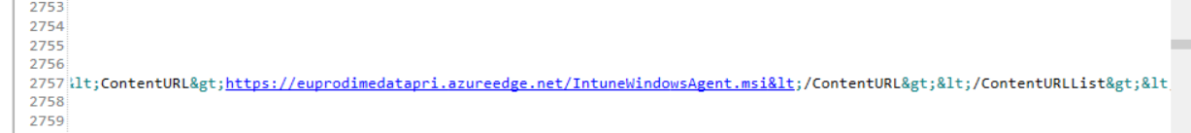
How is the IME installed?
View the SyncML message where OMA-DM initiates the MSI install for the IME
https://github.com/okieselbach/SyncMLViewer

Slide 11

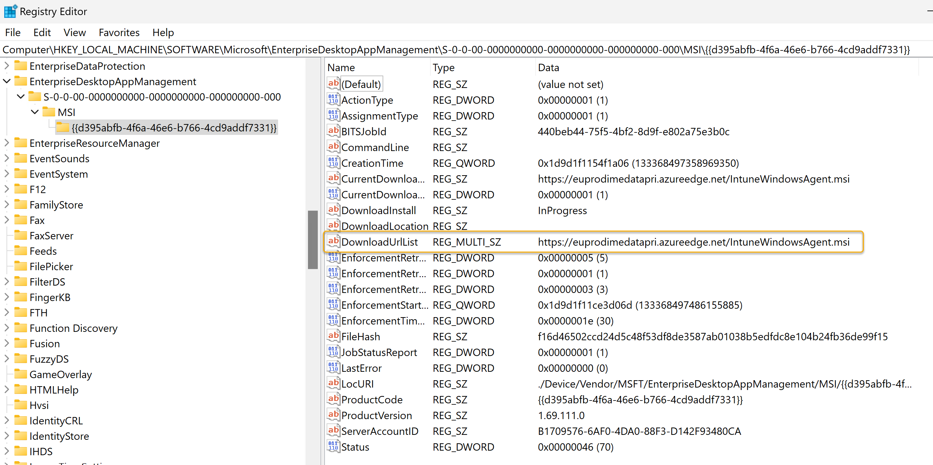

How is the IME installed?
You can track the install via the local registry
HKEY_LOCAL_MACHINE\SOFTWARE\Microsoft\EnterpriseDesktopAppManagement\ S-0-0-00-0000000000-0000000000-000000000-000\MSI
Version downloaded depends on Intune Scale set
New versions are rolled out automatically
Snapshots are a curse

Slide 12
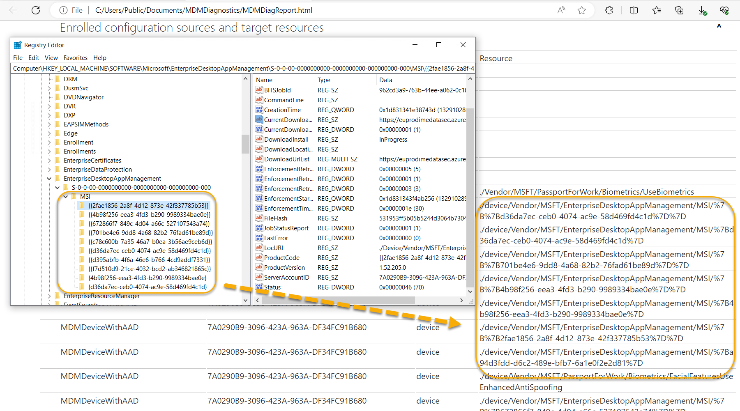

How is the IME installed?
MDM Diagnostics Report
Do Not Uninstall it – pain will follow
https://euprodimedatasec.azureedge.net/IntuneWindowsAgent.msi

Slide 13


How is the IME installed?
LAB Time
BW-W11-5
Snapshot: PreAADJoin Shift F10 during OOBE and install SyncML/View Registry
https://github.com/okieselbach/SyncMLViewer/blob/master/SyncMLViewer/dist/SyncMLViewer-v108.zip

Slide 14
How does the IME process app policy?

Slide 15

How does the IME process app policy?
IntuneManagementExtension.log
Contains information about the activities and processes related to the execution of scripts and installation of apps deployed through Microsoft Intune. It provides insights into how the IME is functioning on the device and can be useful for troubleshooting and monitoring purposes
AgentExecutor.log
Contains information about the execution of scripts deployed through Microsoft Intune
HealthScripts.log
Contains information about proactive remediation scripts deployed through Microsoft Intune
Still Curious to know more? Find the logs
C:\ProgramData\Microsoft\IntuneManagementExtension\Logs

Slide 16

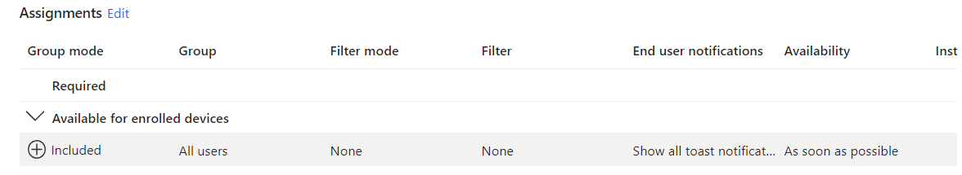

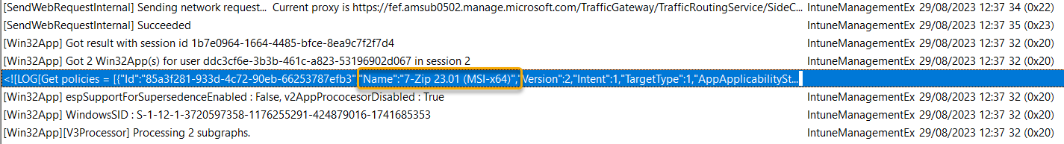

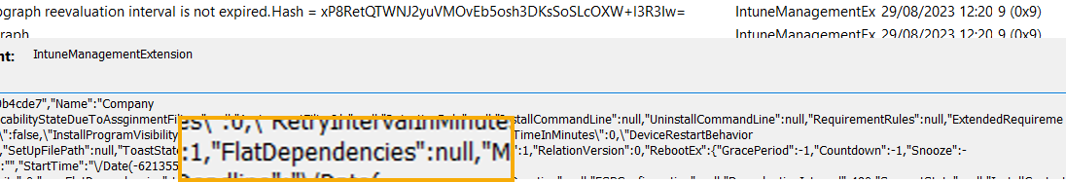


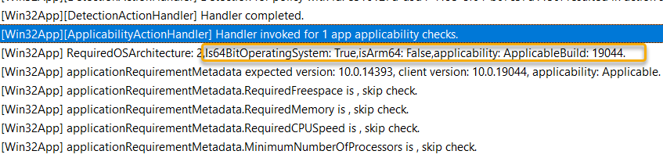
How does the IME process app policy?
Policy is deployed
Policy reaches the device
Dependencies checked
Detection rule checked
Applicability and requirements checked

Slide 17

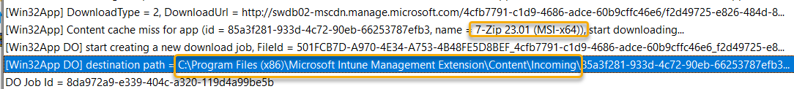

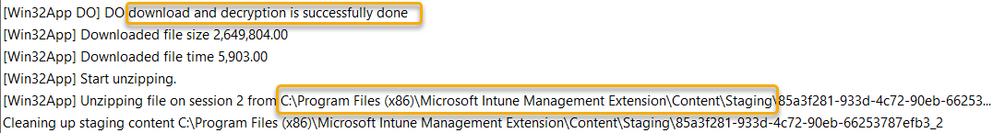

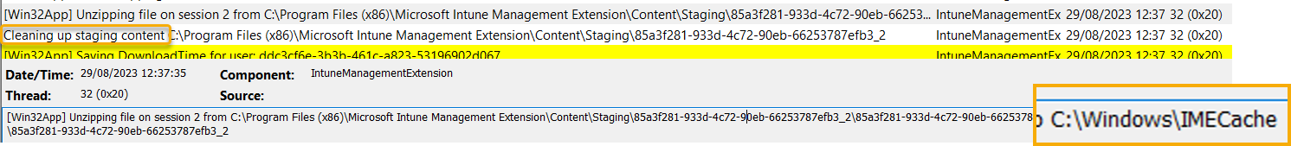

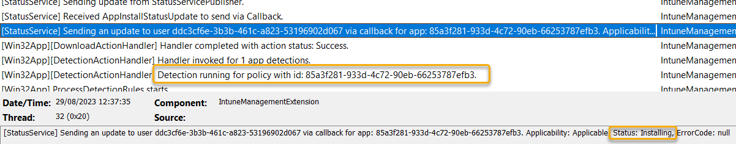

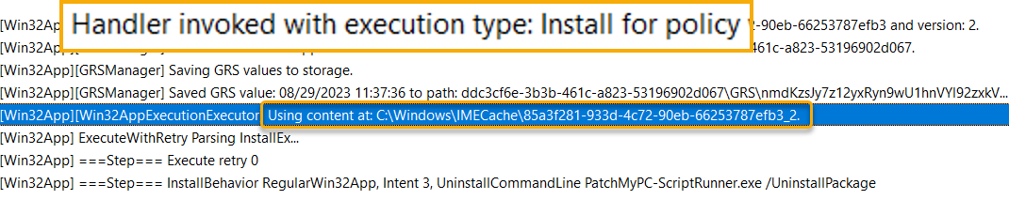
How does the IME process app policy?
IME begins content download (content phase 1)
IME validate the package and decrypts content (content phase 2)
Content cleaned up and moved (content phase 3)
App install begins (Detection run again)
App install continues

Slide 18
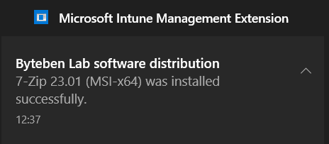
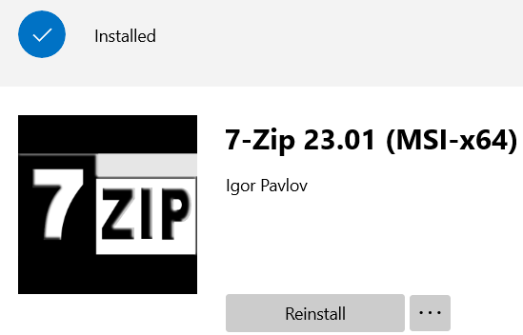

How does the IME process app policy?
Reboot Manager checks exit code for reboot requirement and content cleaned up
Detection reevaluated
Compliance state set in registry and sent to the Intune service
Toast Success or Company Portal update
Drink Coffee

Slide 19
How does the IME process Scripts?

Slide 20
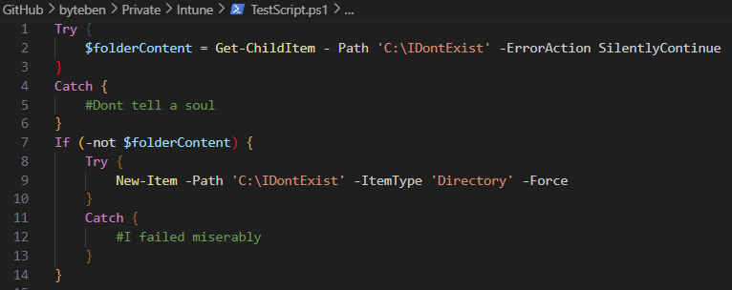

How does the IME process Scripts?
Simple Script Deployed From Intune
Let’s Follow the Flow

Slide 21
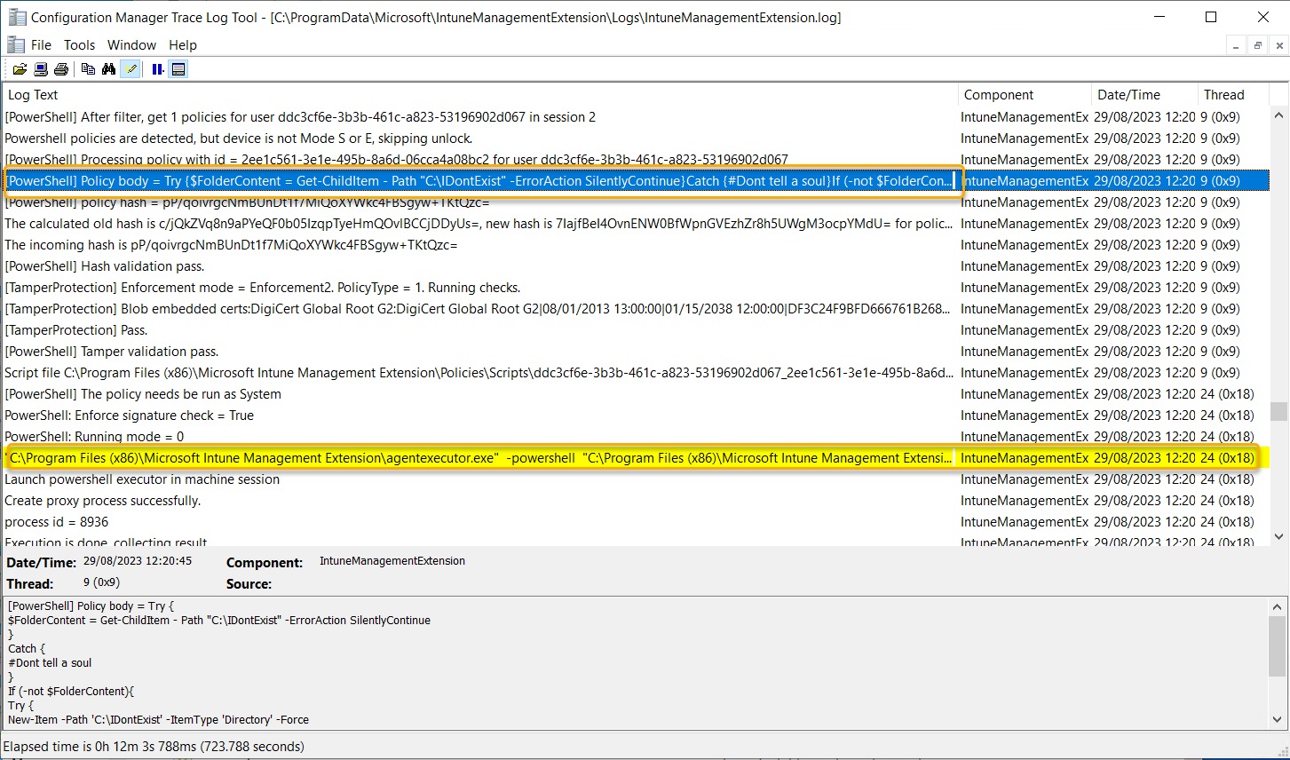

How does the IME process scripts?

Slide 22
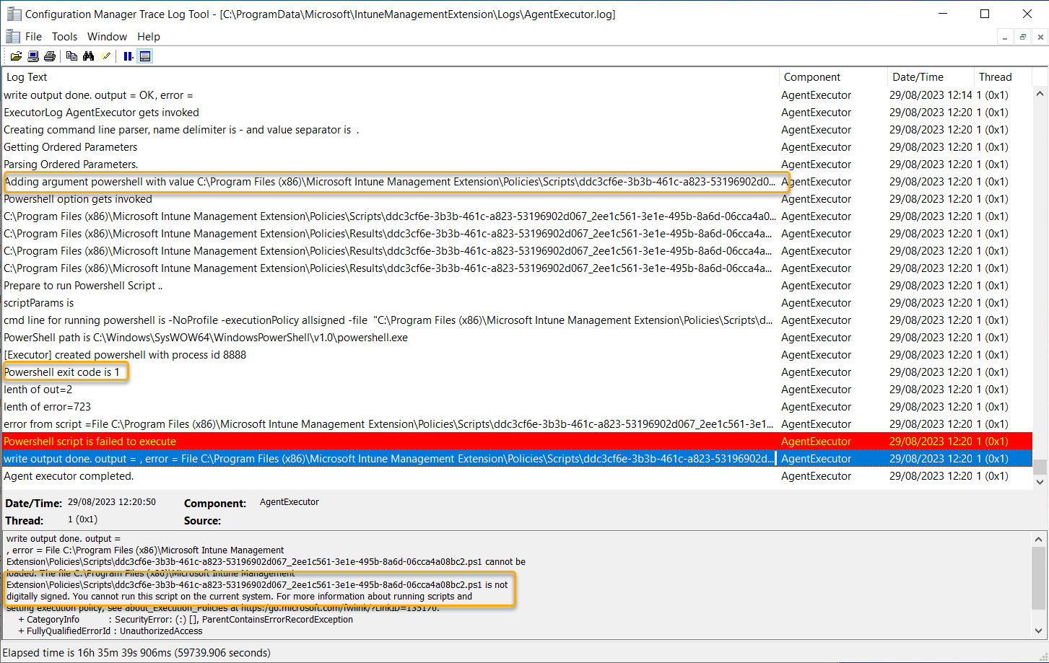

How does the IME process scripts?

Slide 23
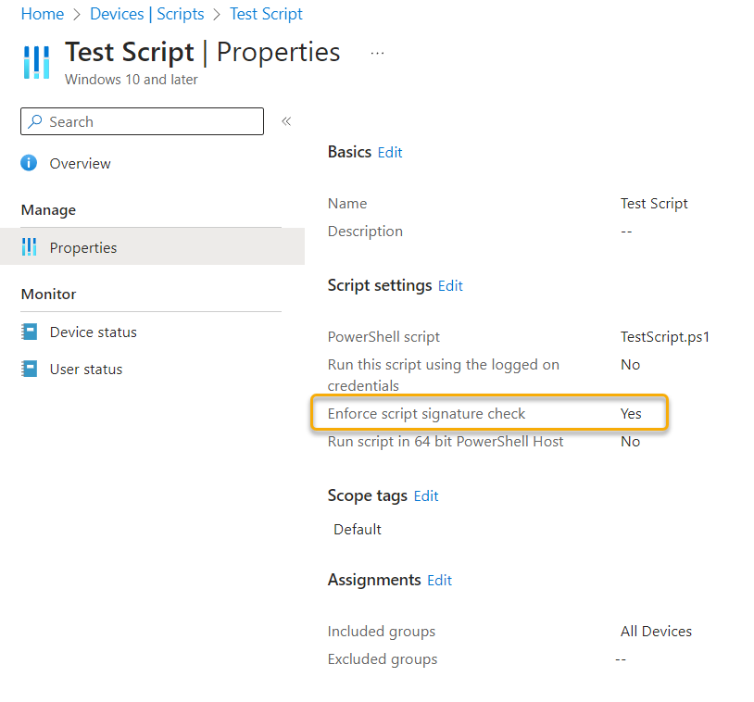
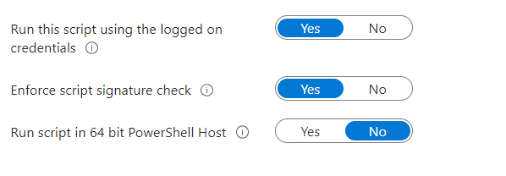
How does the IME process scripts?
Enforce script signature enabled by default

Slide 24
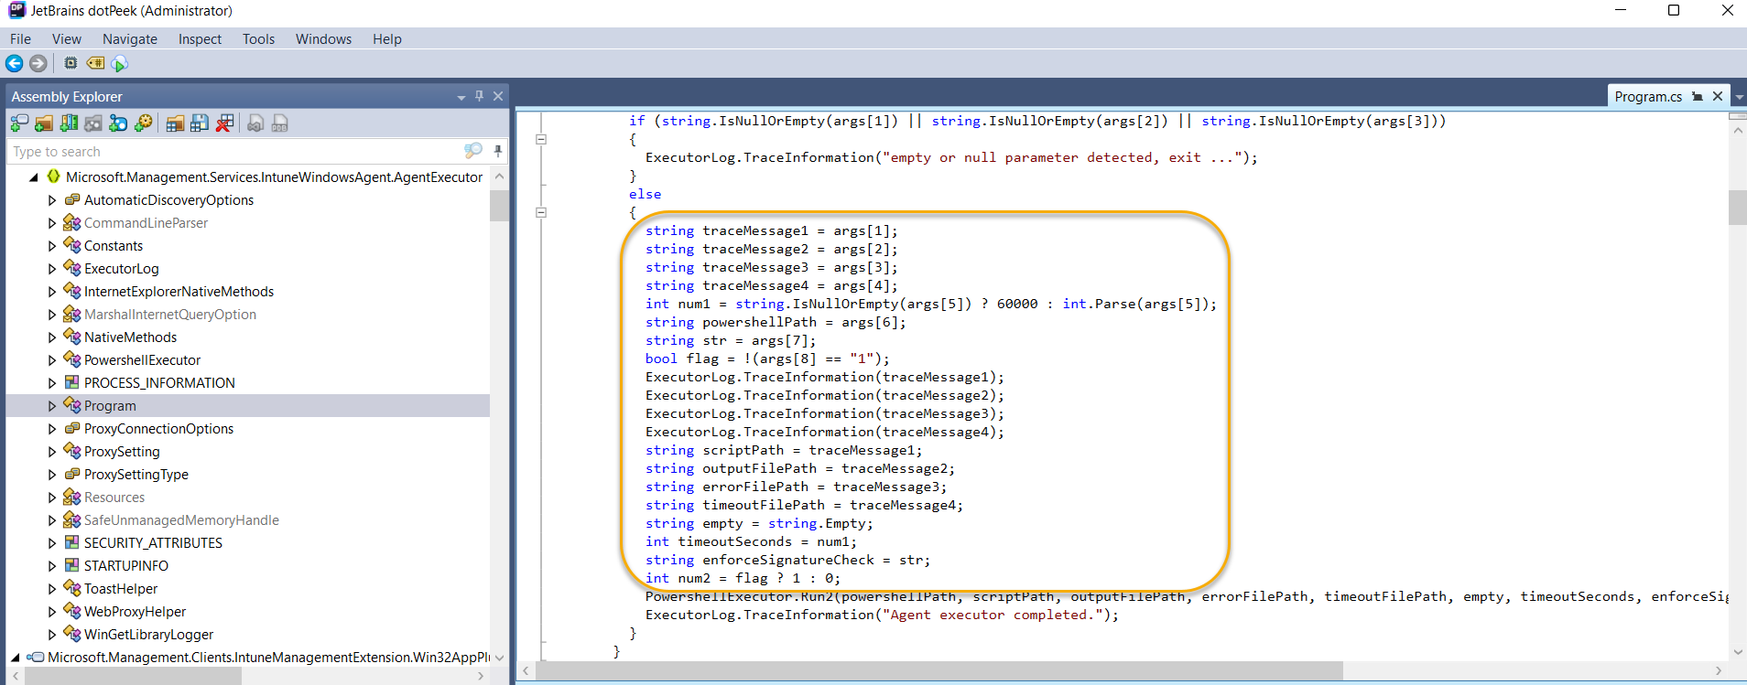
How does the IME process scripts?
Agent Executor is a pretty simple little program really
PowershellExecutor.Run2(powershellPath, scriptPath, outputFilePath, errorFilePath, timeoutFilePath, empty, timeoutSeconds, enforceSignatureCheck, runAs32BitOn64: (num2 != 0))

Slide 25
Digging into win32 app policy event state messages

Slide 26
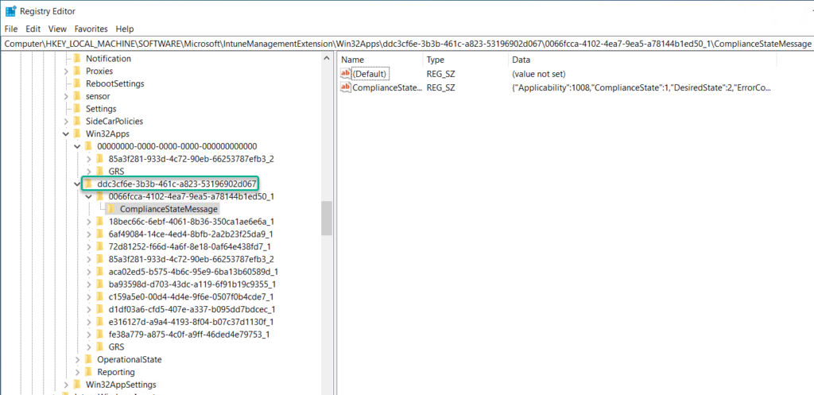


Digging into win32 app policy event state messages
Win32 app policy events are stored in the registry
Apps deployed to the device
Apps deployed to the User (EntraID Object GUID)
HLKM:SOFTWARE\Microsoft\IntuneManagementExtension\Win32Apps

Slide 27
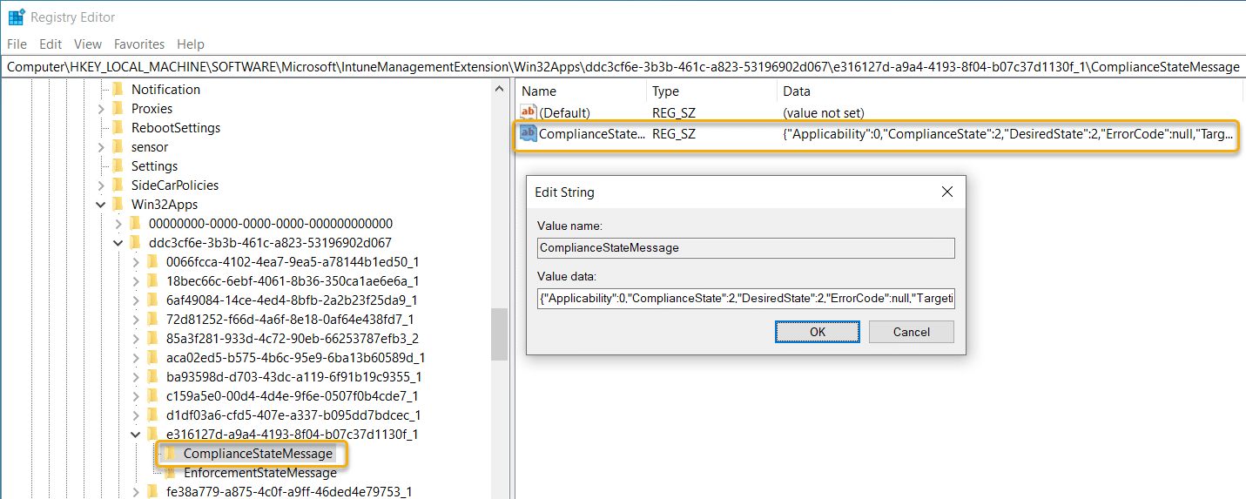
Digging into win32 app policy event state messages
Win32 app policy events are stored in the registry

Slide 28
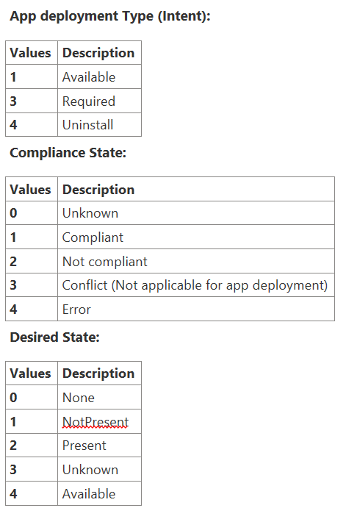
Digging into win32app policy event state messages
State Message

Slide 29
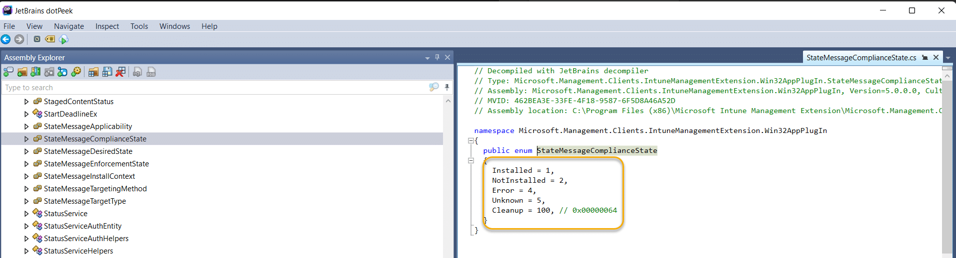
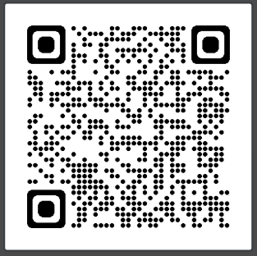
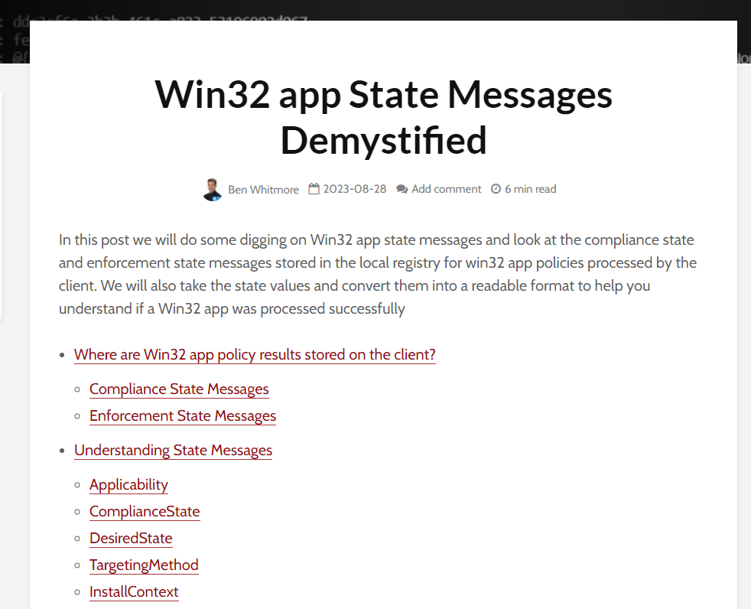
Digging into win32app policy event state messages
State Message Magic?
$stateMessageComplianceState = @{
1 = "Installed"
2 = "NotInstalled"
4 = "Error"
5 = "Unknown"
100 = "Cleanup"
}
# tables FTW

Slide 30
Digging into win32app policy event state messages
LAB Time
BB-W10-5
Registry State messages
PowerShell

Slide 31
Try again. How the IME handles failures and retries

Slide 32
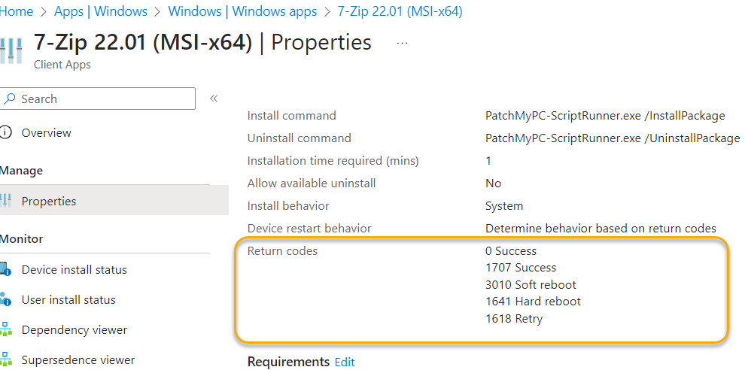

Try again. How the IME handles failures and retries
Failed apps retried every 24 hours if they are required and the installer exits with a failure or unknown exit code
3x1t C0d35 ar3 1mp0rt4nt
Failed apps retried every 3 times every 5 minutes and then every 24 hours if they are required and the installer exits with a known retry code

Slide 33
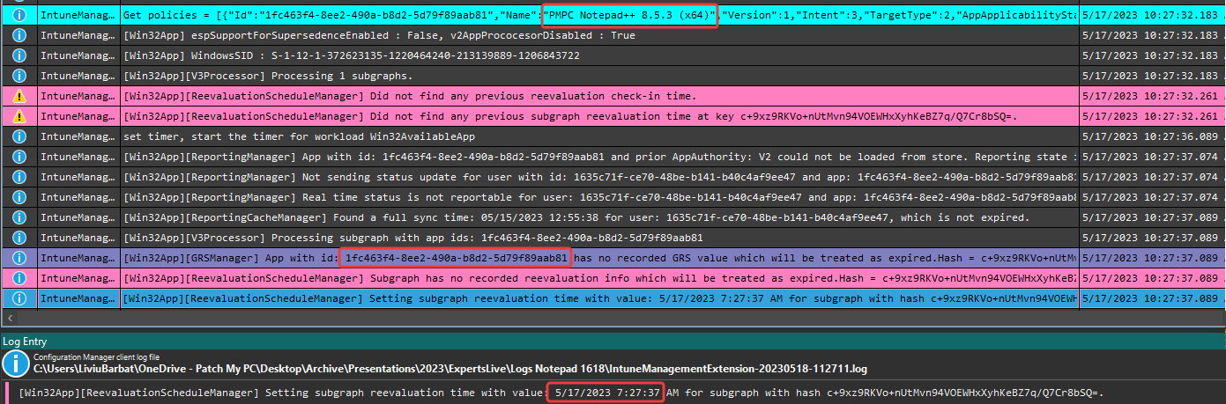

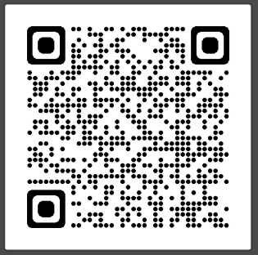

Try again. How the IME handles failures and retries
The ReevaluationScheduleManager, also known as the Global Retry Schedule (GRS) is responsible for scheduling policy that is delayed
LiviuBarbat.info / PatchTuesday.com

Slide 34
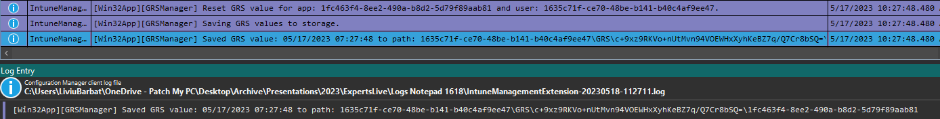
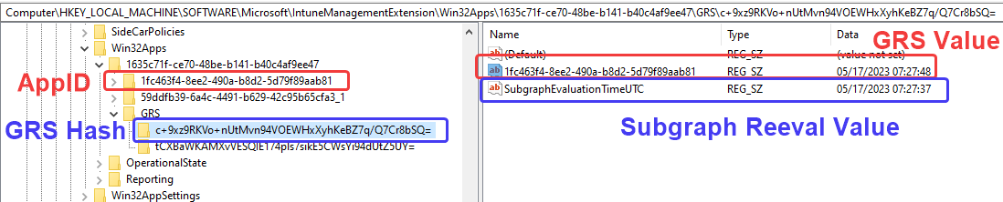
Try again. How the IME handles failures and retries
Policy is processed and GRS key is set

Slide 35
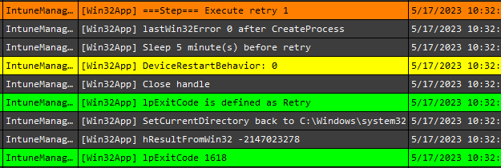
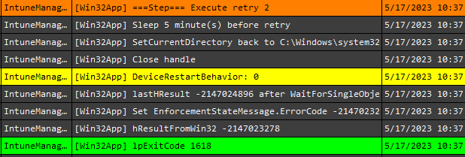
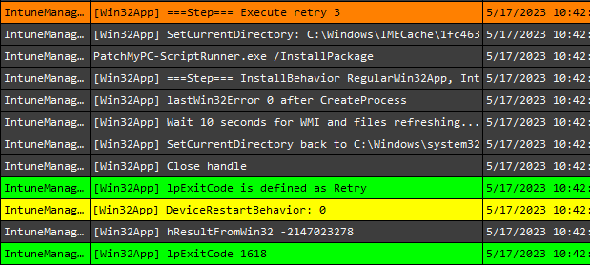
Try again. How the IME handles failures and retries
In this example, the app installer terminated with a known retry code and tried 3 more times to attempt the installation (5 minute intervals)

Slide 36
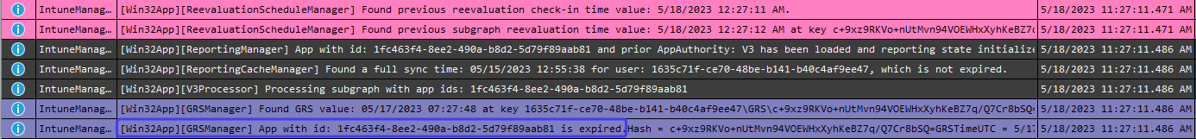

Try again. How the IME handles failures and retries
After 3 failed retries, the policy will be tried again in 24 hours time when the GRS value expires
GRS is expired

Slide 37
Try again. How the IME handles failures and retries
GRS Summary
Policy evaluated and installer begins
If installer fails, does the exit code indicate “Retry”? If so, retry 3 more times every 5 minutes
If installer is failed (still), add the app to the GRS
Evaluate a sub graph every 8 hours to check when 24 hours have passed since the app was added to GRS
After 24 hours, retry the installation
Repeat forever

Slide 38
Inventory

Slide 39
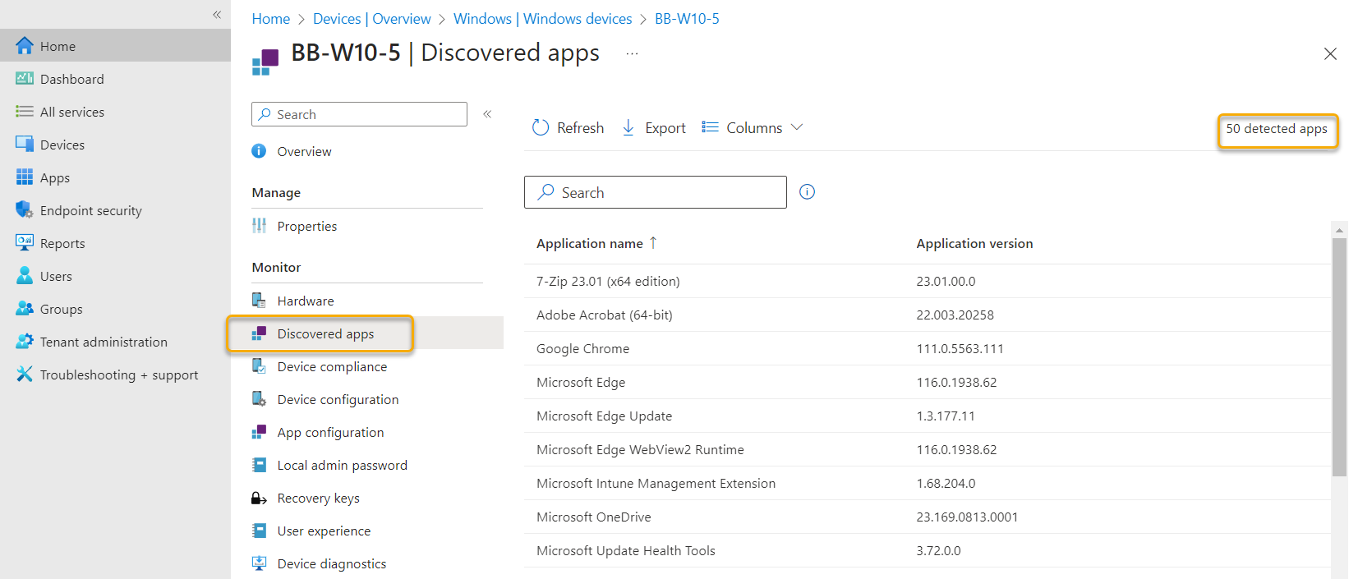
Inventory
The IME will inventory installed applications. The results are sent to the Intune service and are visible in two endpoints

Slide 40
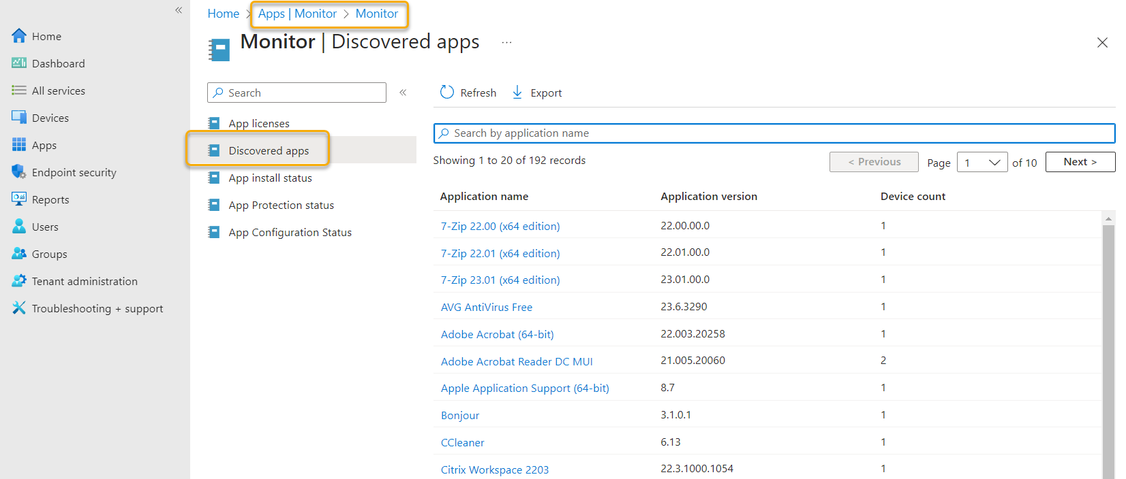
Inventory
Aggregated report for all devices is under Apps > Monitor > Discovered Apps

Slide 41
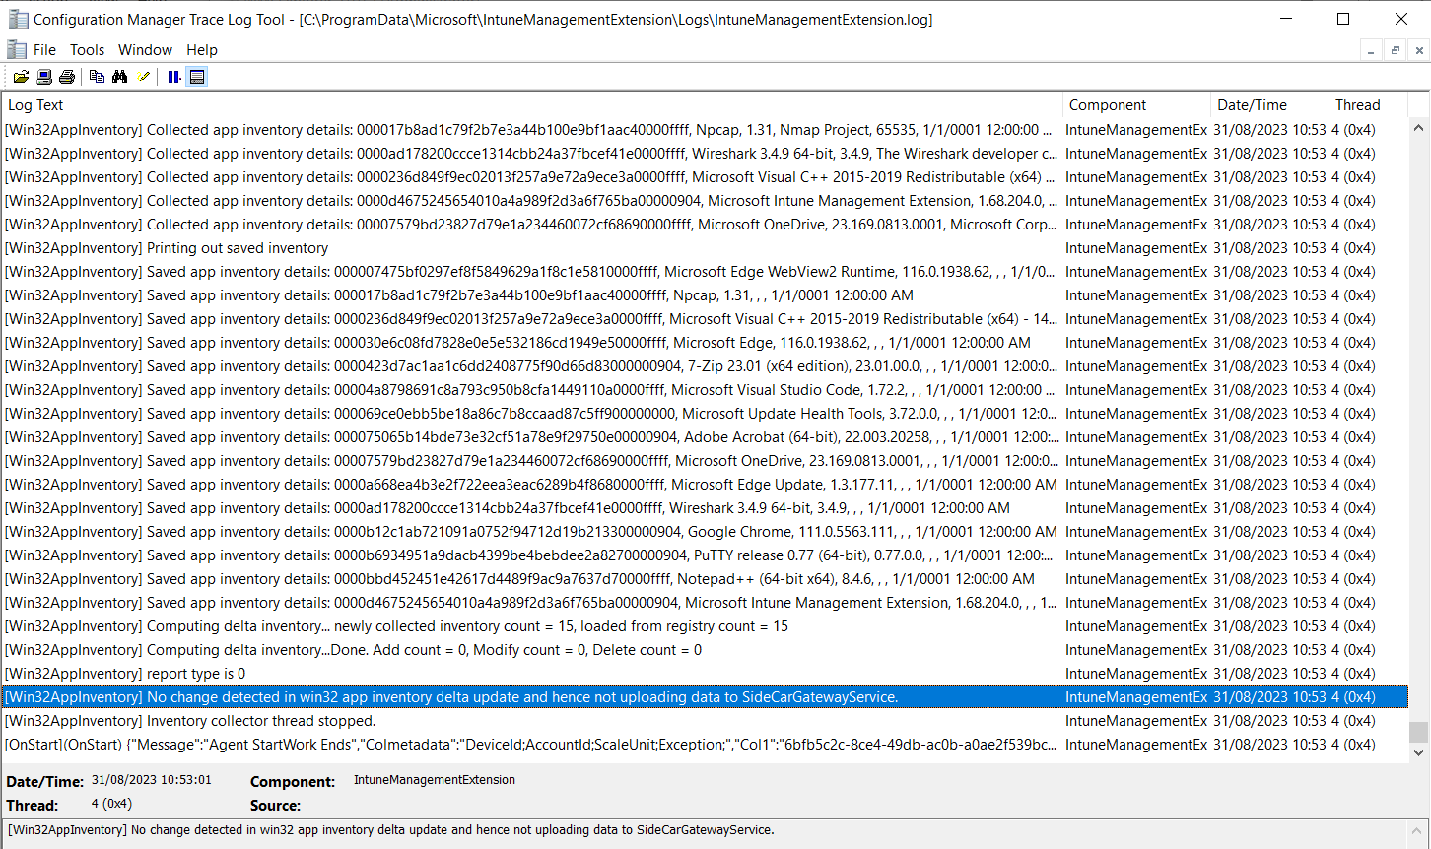
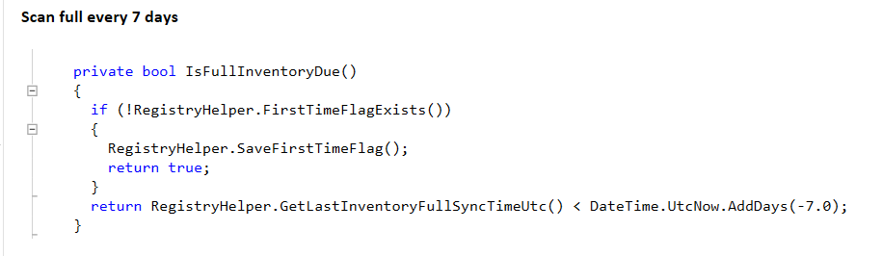
Inventory
The IME performs a delta inventory every 24hrs and/or when the IME service starts. A full inventory is taken every 7 days and the first time the IME is installed
Remember .NET disassemblers!

Slide 42
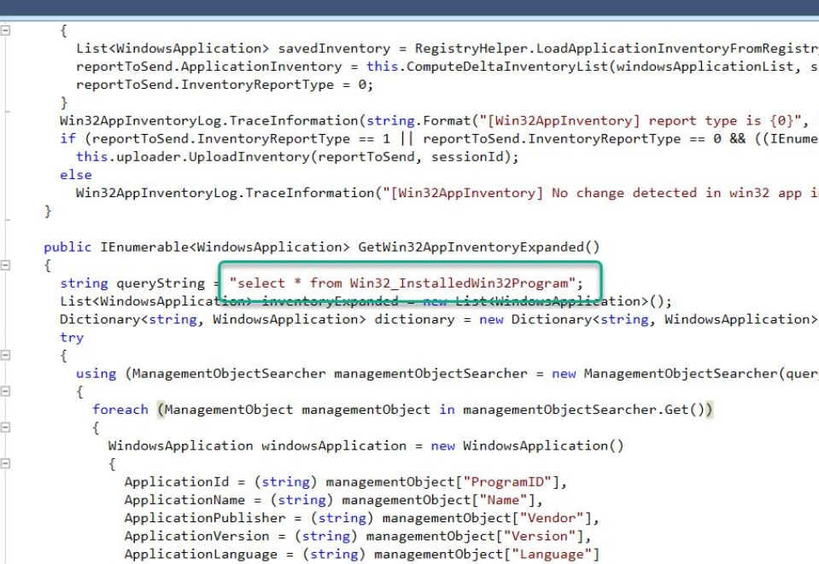

Inventory
The IME uses a specific WMI class to query installed software
Remember .NET disassemblers!
Win32_ InstalledWin32Program

Slide 43
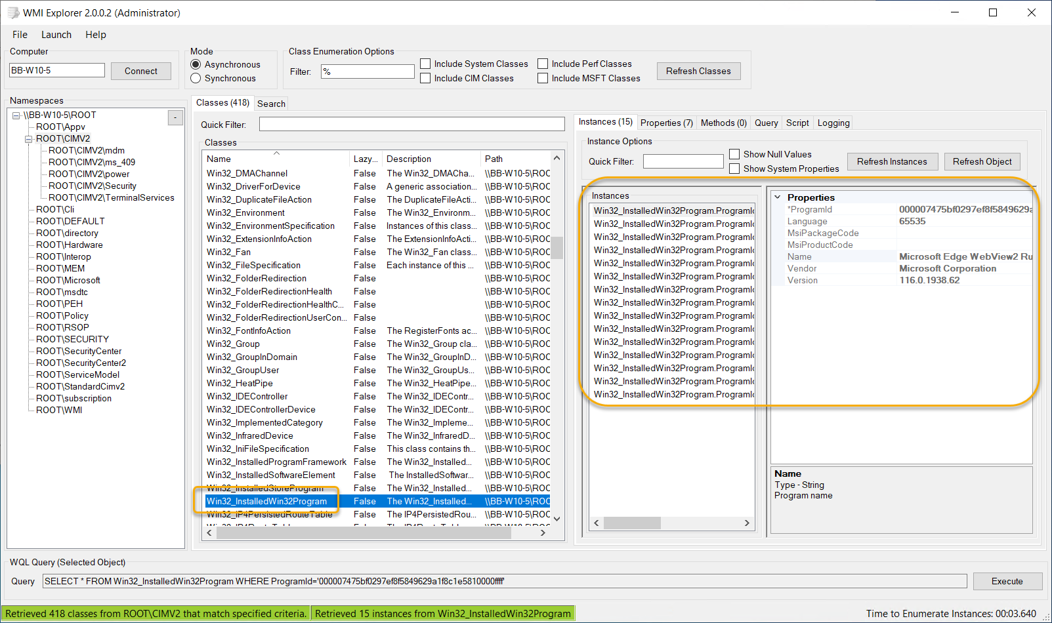
Inventory

Slide 44
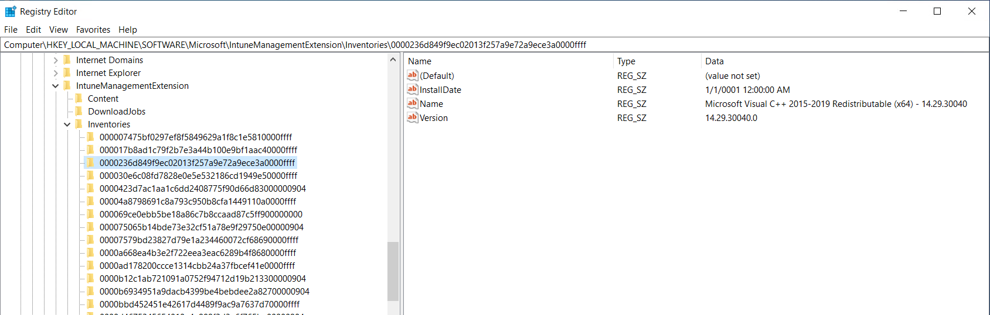
Inventory
Inventory is saved in the registry so a delta can be performed on the next scan
HKEY_LOCAL_MACHINE\SOFTWARE\Microsoft\IntuneManagementExtension\Inventories

Slide 45
Digging into win32app policy event state messages
LAB Time
BB-W10-5
Force Delta Inventory and Full Inventory

Slide 46
Inventory
Inventory Summary
New apps appear in Intune reports fairly quickly
It can take up to 7 days for delta changes (removes) to be reflected in Intune reports
Inventory is run every 24 hours
A full inventory is run the first time and every 7 days, a delta inventory occurs subsequent runs
Delete FirstTimeRun key to force a full inventory

Slide 47
Invoke IME actions like a boss

Slide 48

Invoke IME actions like a boss
Process and re-process policy – what are your options?
The IME will check app policy every 60 minutes and also when the IME service is started
What if you wanted to invoke a policy evaluation immediately?

Slide 49
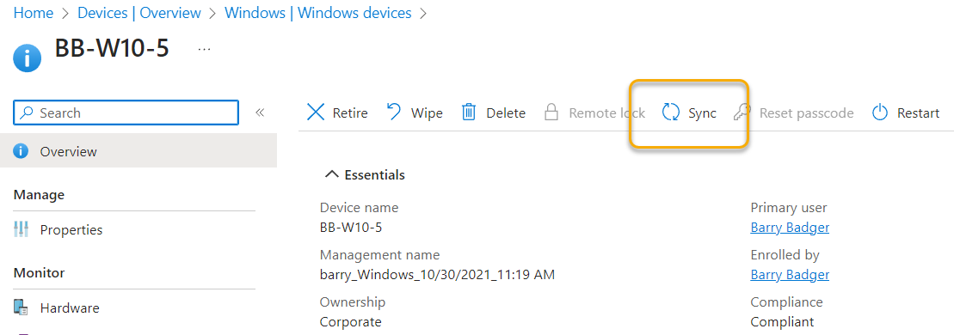
Invoke IME actions like a boss
Process and re-process policy – what are your options?
Perform a sync from the Intune Admin Center

Slide 50
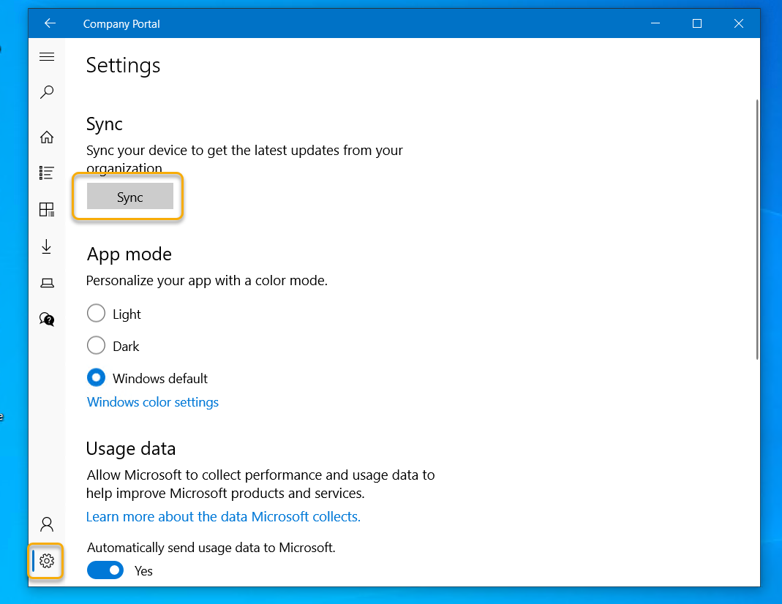
Invoke IME actions like a boss
Perform a sync from the Company Portal

Slide 51
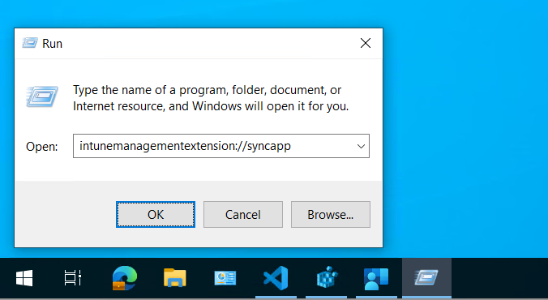
Invoke IME actions like a boss
Perform a sync from the start menu (process app policy only)
intunemanagementextension://syncapp

Slide 52
Invoke IME actions like a boss
Trigger a sync from PowerShell (process app policy only)
$newShell = New-Object -ComObject Shell.Application
$newShell.open("intunemanagementextension://syncapp")

Slide 53
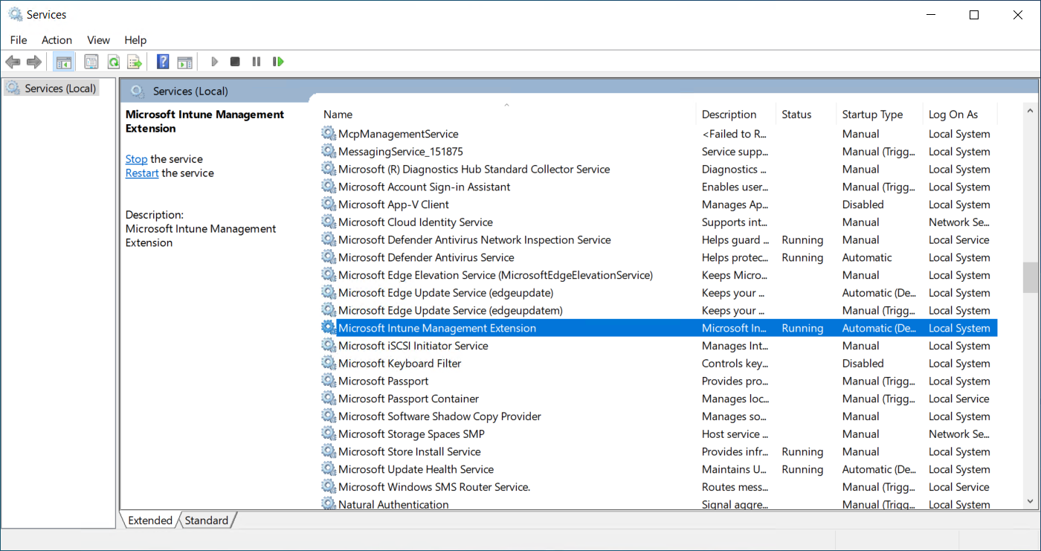
Invoke IME actions like a boss
Restart the IME Windows Service

Slide 54
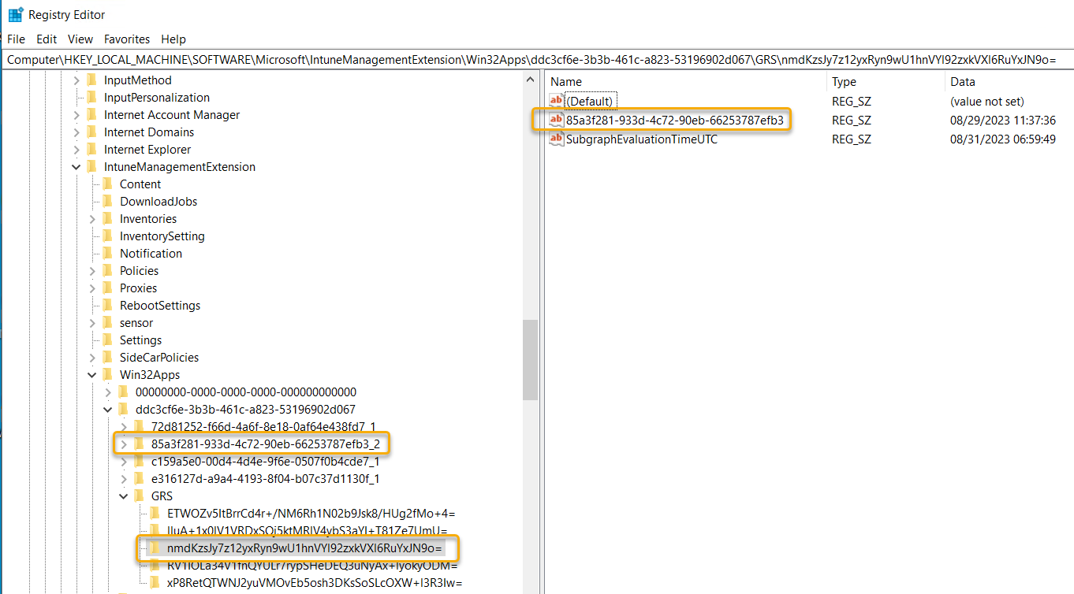

Invoke IME actions like a boss
Q: What if you wanted to invoke a policy evaluation immediately for a failed app? A: Wait 24hrs – aint no one got any time for that!
Delete the app key and the GRS key from the registry

Slide 55
What Next?
Q&A IME Bridge Get Detection Scripts with a File Watcher

